Slide 1

Python Lecture 2
Tanay Bhadra (message on Slack if you have questions!)
Curriculum Manager
ULAB Physics and Astronomy

Slide 2
Goal of this Lecture
Understand Python Division, Floor Division and Modulo
Explore Python on the Jupyter.
Variables
Lists
Conditionals
Great Rule of Equality

Slide 3
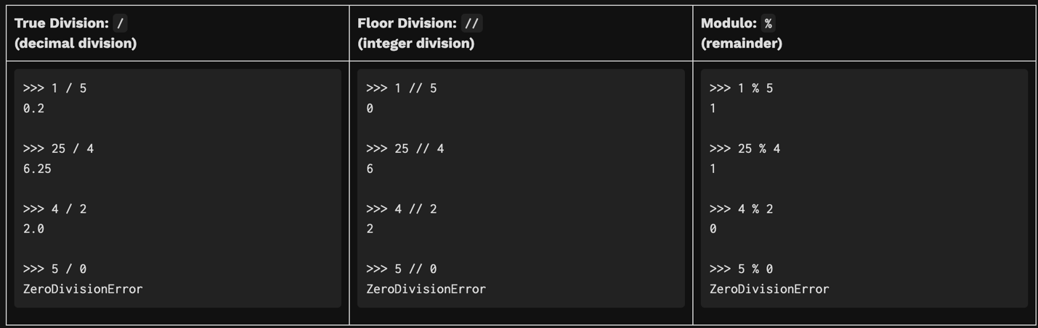
Division, Floor Division, Modulo

Slide 4
Variables
Data Type | Explanation | Example
Integer (Int) | Positive or negative integer | A = 5
Float | Decimal (floating point) number | A = 3.1415926
Boolean (Bool) | True or False | A = True or A = False
List | Ordered List of Value | A = [1, 2, 3]
String (Str) | A List of Characters (text) | A = ‘Marvin the depressed robot’
Dictionary (Dict) | A mapping of keys and values | A = {‘e’:2.718, ‘pi’, 3.141}
None | Nonetype (null or missing value) | A = None
Variables are containers that store the data we want to keep track of.
To find the variable type, we use the type() function where the variable is passed in as an input to the function. Our variable type can change dynamically. If I declare A as an integer, I can change it to be a Boolean value in the very next step.

Slide 5
Print Statements and Operations
Operator | Name | Example
+ | Addition | A + B
- | Subtraction | A - B
* | Multiplication | A*B
** | Exponentiation | A**B
== | Equal | A == B
!= | Not equal | A!=B
> | Greater Than | A > B
< | Less than | A < B
>= | Greater Than or Equal To | A >= B
<= | Less than Or Equal To | A <= B
and | As a condition, it returns true if both statements are true. If you enter raw conditions without control statements (if clauses), if there is one false statement, returns first False statement. If both are True, returns the last True Statement. | A > B and B > C
or | As a condition, it returns true if both statements are true. If you enter raw conditions without control statements (if clauses), if there is one false statement, returns first True statement. If both are True, returns the last True Statement. | A > B or B > C
not | If result is True, returns false | not (A < B)

Slide 6
Lists
List Elements | 1 | 2 | 3
Forward Index | 0 | 1 | 2
Reverse Index | -3 | -2 | -1
A list is a data structure that acts like a container and stores multiple elements. Each element can be of any type, even a list itself.
Lists are accessed with their index.
We can also slice lists. Slicing a list creates a copy of part or all of list.

Slide 7
Conditionals
Conditionals are also known as control statements because they literally control the flow of your code. It has the following structure:
If CONDITION:
[Do Something]
elif CONDITION:
[Do Something Else]
else:
[When everything else fails, do this]

Slide 8
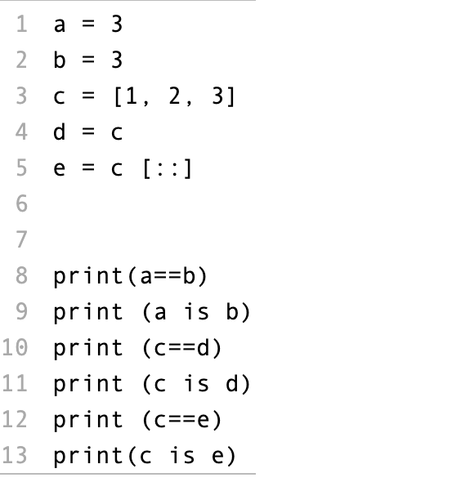
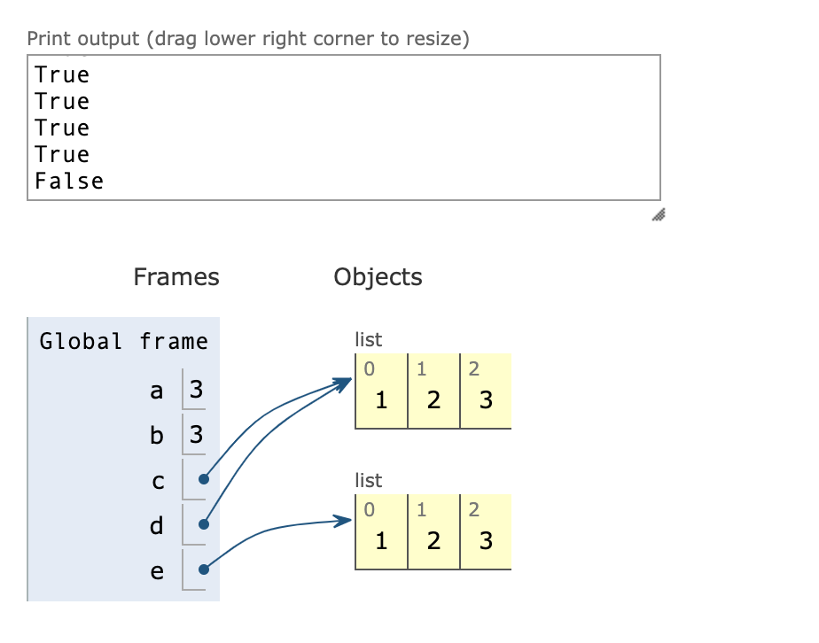
Great Rule of Equality

